Slide 1
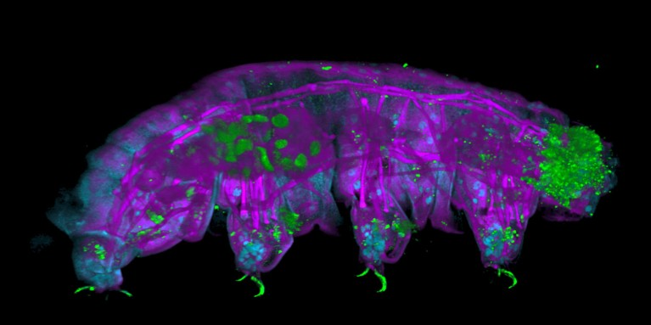
Investigating the Diversity of Tardigrades in Different Geographical Distributions with BOLD database
By: Liona Vu
BINF6210 Assignment 1
Photo credit: Ana Lyons
https://www.nature.com/articles/d41586-025-01971-7

Slide 2
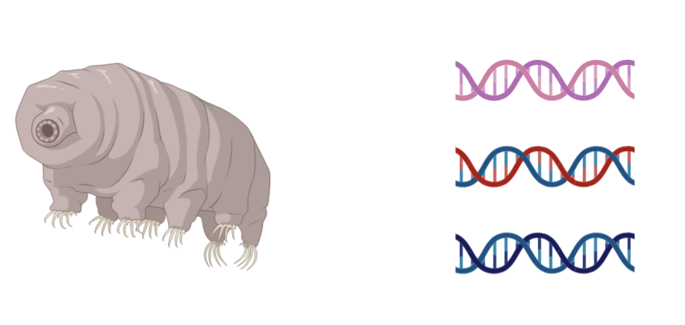
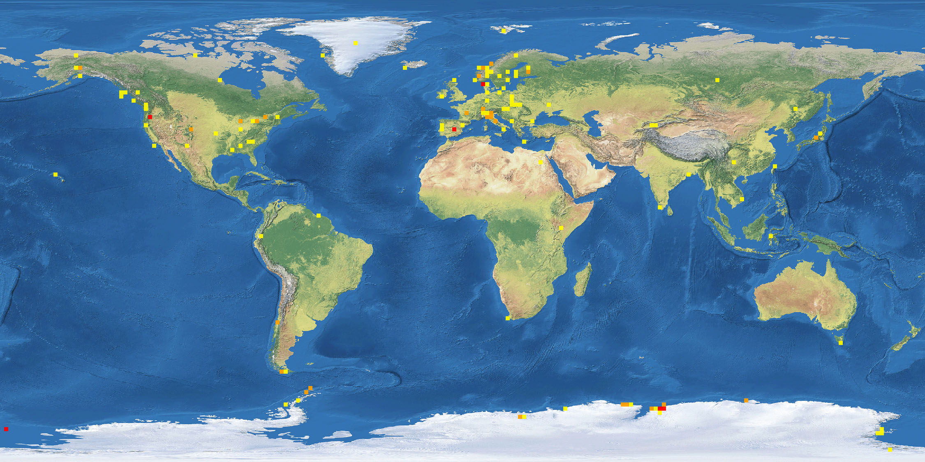
Tardigrades are found throughout the world and are extremely resilient
Tardigrades, also known as water bears, are ubiquitous
Only 0.5mm long
Despite their small size, tardigrades are interesting in the biological sense because they
are extremely resilient and can survive harsh conditions including :
dehydration and dessication
through anhydrobiosis process
(Horikawa et al., 2008)
under high pressure
(Seki and Toyoshima., 1998)
both in extreme high and low
temperatures (Arakawa, 2022)
have been documented in
cold climates such as in
Antarctica
Image from https://v3.boldsystems.org/index.php/Taxbrowser_Taxonpage?taxid=26033

Slide 3
Studying tardigrades can help us to answer relevant biological questions
Why study Tardigrades?
Biodiversity: Since they inhabit all corners of the world (from mountains to tropical rainforests), we can gain insight into their biodiversity through COI (cytochrome c oxidase I) DNA barcoding and their roles in ecology
Evolutionary insight: Reveals how tardigrades have developed their extreme resilience traits and understand its underlying molecular mechanisms
Relevant applications in biotechnology: For example, we can investigate their anhydrobiosis ability, identify potential genes/proteins, and apply to plant agriculture to create drought resilient crops due to the effects climate change (Sanchez et al., 2023)

Slide 4
Gap in Knowledge of Tardigrade Biodiversity
Despite their amazing research potential, environmental adaptability, and ubiquitous nature, tardigrade biodiversity remains poorly understood.
?
Figure created in BioRender.com

Slide 5
Using the BOLD database to explore and investigate tardigrade biodiversity
OBJECTIVES
Investigate how Tardigrade diversity (i.e. total number of unique BINs, Shannon’s index) differ across North America, South America, and Antarctica.
Investigate how well sampled tardigrades are across North America, South America, and Antarctica.
EXPLORATORY/WORKING HYPOTHESIS Tardigrade biodiversity varies across different continents, with more sampling efforts resulting in higher diversity.

Slide 6
Methodological framework to investigate tardigrade diversity through RStudio
1. Define the questions / objectives
2. Input: Extact tardigrade data from BOLD database
3. Filter and clean data (Packages: dplyr, tidyverse, janitor)
6. Communicate findings and interpretation (storyboard)
5. Statistical analysis and testing (p value)
4. Data visualizations (Packages: base R, ggplot2, ggpubr, vegan)

Slide 7
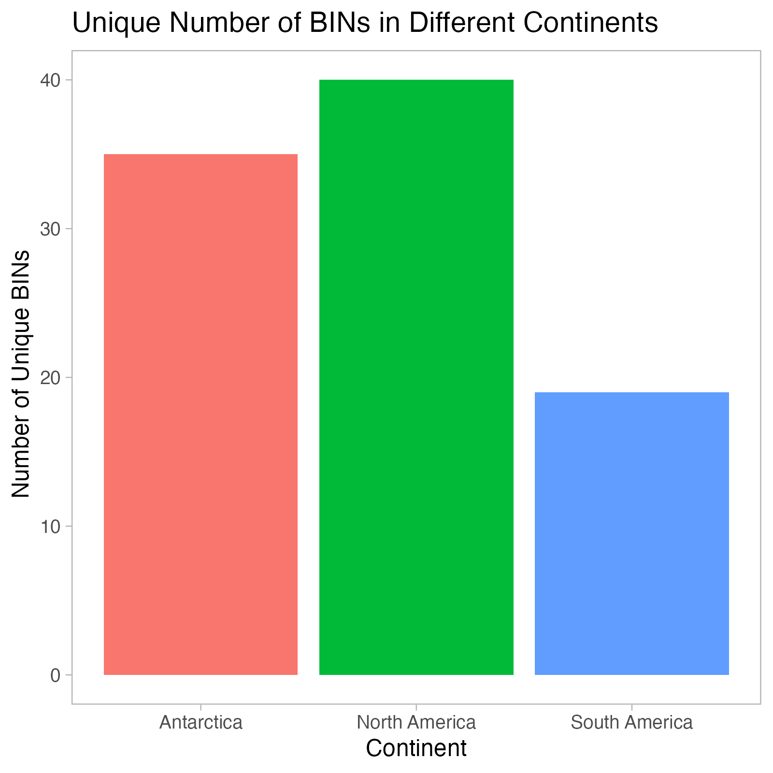
North America has greater number of unique BINs than Antarctica and South America
BIN – Barcode Index Numbers

Slide 8
Results and discussion: North America has greater number of unique BINs than Antarctica and South America
Unique BINs count for each continent:
Antarctica: 35
North America: 40
South America: 19
Impact on objective 1 – based solely on observation, results implies that North America has greater genetic Tardigrade diversity than Antarctica and South America
However, must interpret the results with a grain of salt as dataset may be:
Biased due to uneven sampling efforts such as North America having greater sampling efforts than South America
Need to plot rarefaction curve to confirm speculations

Slide 9
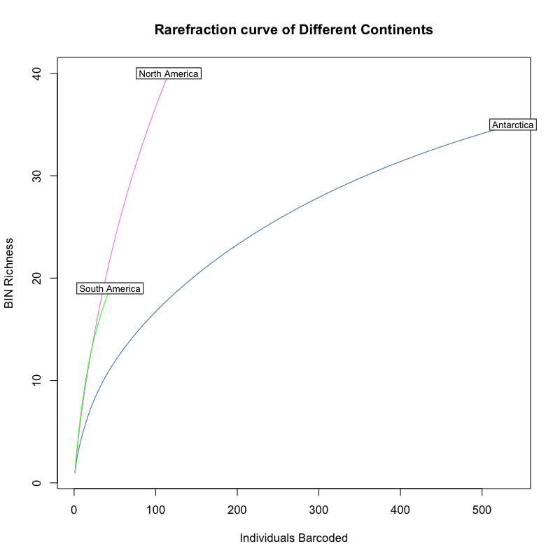
Rarefaction curve by continent reveal distinct sampling efforts

Slide 10
Results and discussion: Rarefaction curve by continent reveal distinct sampling efforts
Both North America’s and South America’s rarefaction curve are steep and have short curves, with South America having the shortest curve
Impact on objective 2 – sampling efforts are not complete, both continents are under sampled
In fact, literature states only 44.5% of tardigrades species have been discovered (Bartels et al., 2016)
Antarctica’s rarefaction curve is less steep and is beginning to plateau but has a longer curve than both North and South America
Impact on objective 2 – sampling efforts are more complete than North and South America
Impact on working hypothesis – gives evidence that more sampling efforts results in greater diversity, with more BINs discovered as more sampling is done (North America vs South America)
Antarctica is an interesting case, as more individuals are barcoded but has 35 unique BINs while North America sampling efforts is incomplete yet has more unique BINs, 40
Could be due to the unique climate of Antarctica which is cold year-round and can only harbour specific species of tardigrades – potential next step in investigating what species dominate Antarctica
Despite under sampling, is there a still difference in tardigrade diversity between continents?

Slide 11
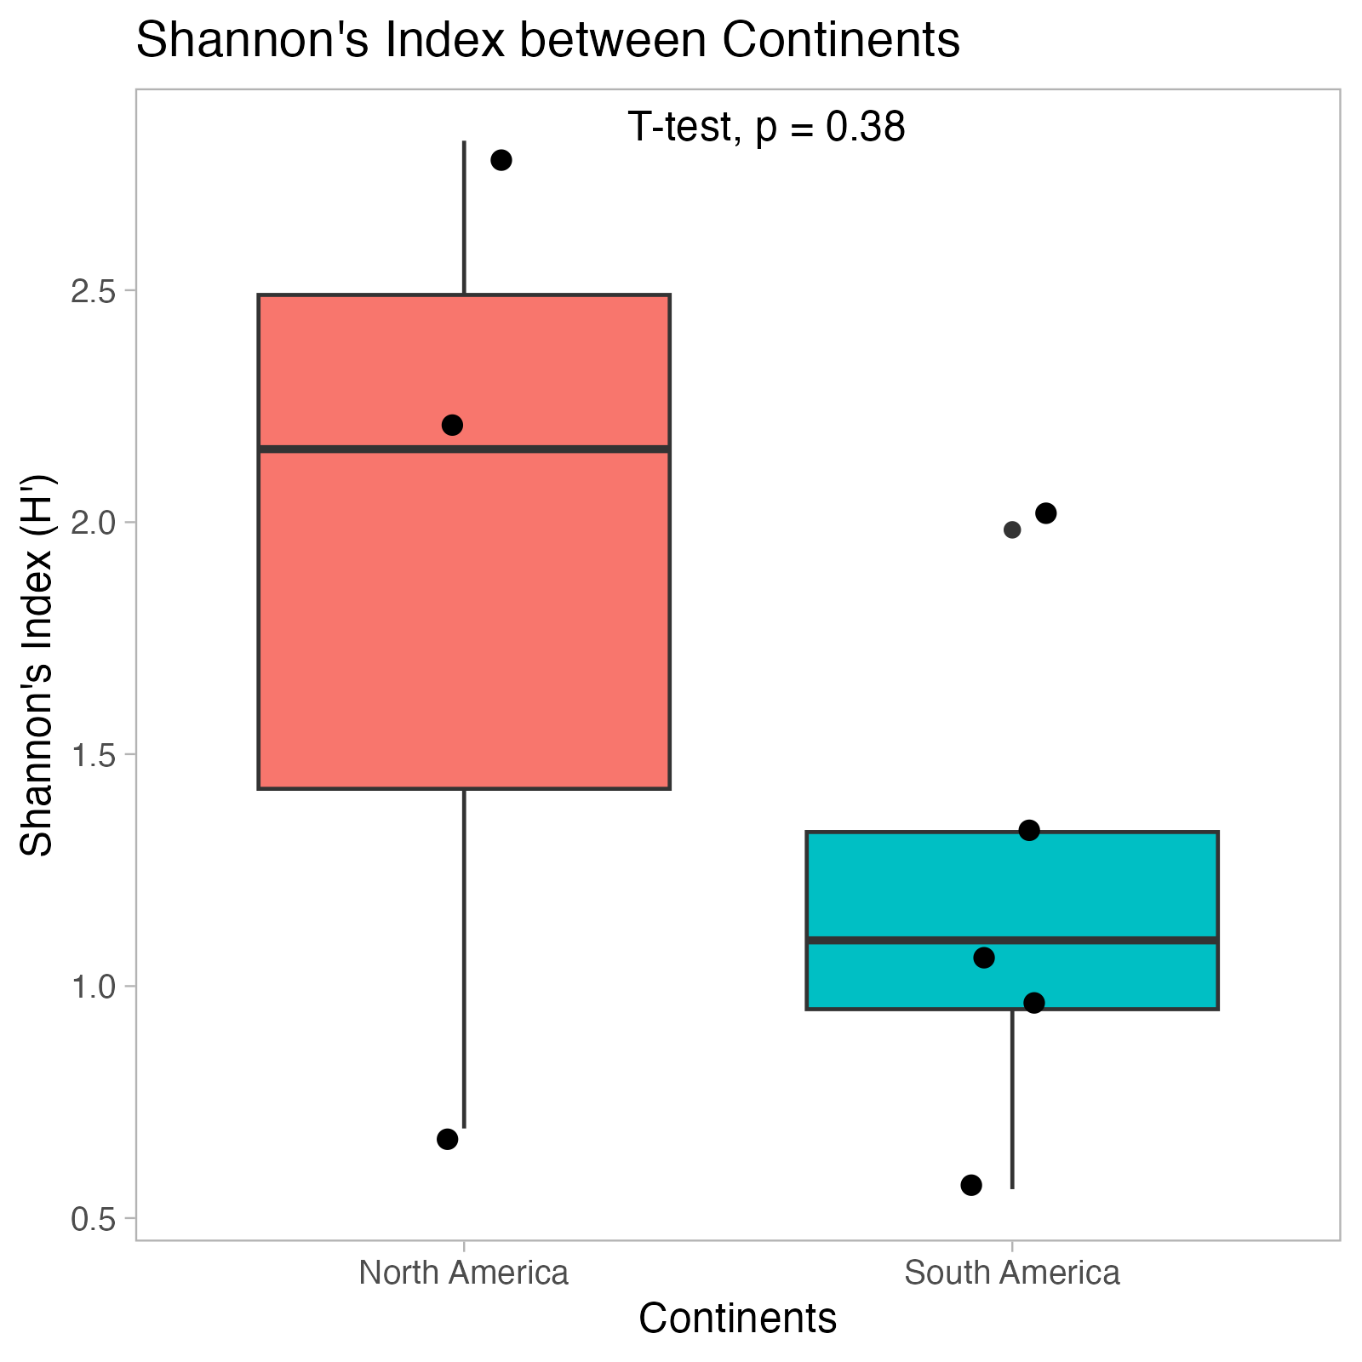
Tardigrade diversity does not differ significantly between North and South America

Slide 12
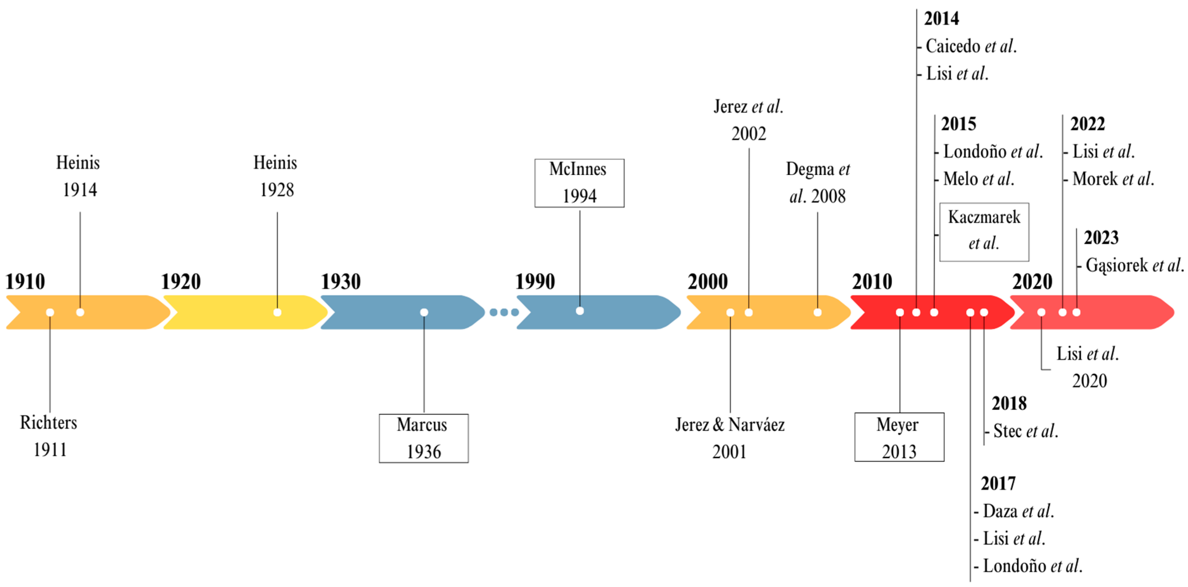
Results and discussion: Tardigrade diversity does not differ significantly between North and South America
Shannon’s Index is a method to measure diversity (Magurran, 2004)
Note that Antarctica was excluded because of having only 1 value (Shannon Index 1.88)
Impact on objective 1 and working hypothesis:
North America has greater Shannon’s index value than South America, but test reveals not statistically significant as p value = 0.38
However, this is still informative as samples could have been lacking statistical power due to uneven/biased sampling size and difference in sampling effort (reinforced by the rarefaction curve in slide 9)
Therefore, more sampling and larger dataset is
required to potentially detect a pattern and
reduce Type II error
Corroborated with literature: Colombia, a country
in South America, has incomplete records of
tardigrade species but progress has recently
picked up in the last 10 years
(Sayas et al., 2024)
Sayas et al., Diversity 2024

Slide 13
References
Horikawa, D. D. et al. Establishment of a Rearing System of the Extremotolerant Tardigrade Ramazzottius varieornatus: A New Model Animal for Astrobiology. Astrobiology 8, 549–556 (2008).
Arakawa, K. Examples of Extreme Survival: Tardigrade Genomics and Molecular Anhydrobiology. Annu Rev Anim Biosci 10, 17–37 (2022).
Seki, K. & Toyoshima, M. Preserving tardigrades under pressure. Nature 395, 853–854 (1998).
Sanchez-Martinez, S., Ramirez, J. F., Meese, E. K., Childs, C. A. & Boothby, T. C. The tardigrade protein CAHS D interacts with, but does not retain, water in hydrated and desiccated systems. Sci Rep 13, 10449 (2023).
Magurran, A. E. Measuring Biological Diversity (Blackwell Publishing, 2004).
Bartels, P. J., Apodaca, J. J., Mora, C. & Nelson, D. R. A global biodiversity estimate of a poorly known taxon: phylum Tardigrada. Zool J Linn Soc 178, 730–736 (2016).
Venencia-Sayas, D. et al. Tardigrades (Tardigrada) of Colombia: Historical Overview, Distribution, New Records, and an Updated Taxonomic Checklist. Diversity (Basel) 16, (2024).

Slide 14
Acknowledgements
Personnel
Thank you Kazeera Aliar, Sharon Tsukernik, Sabrina Saiphoo, Farah Sadoon, and Rebecca Hest for running the R script and ensuring that it runs without any errors.
Thank you, Sabrina and Farah, for their support in reviewing statistical concepts for analysis.
Tutorials Consulted
Plotting and statistical features in R Studio
https://www.sthda.com/english/articles/24-ggpubr-publication-ready-plots/76-add-p-values-and-significance-levels-to-ggplots/
https://www.sthda.com/english/wiki/normality-test-in-r
https://posit.co/wp-content/uploads/2022/10/data-visualization-1.pdf
Vegan tutorials
https://peat-clark.github.io/BIO381/veganTutorial.html
https://www.youtube.com/watch?v=_OEdFjc1D9I
Tardigrade Figures
https://www.biorender.com/

